Slide 1

Detailed explanation of Sutherland-Hodgman algorithm
Tongyi Intelligent PPT

Slide 2


01
Algorithm overview
02
Core principles
03
Algorithm step details
04
Graphic examples and practical applications
content
05
Performance analysis and limitations
catalogue

Slide 3
01
Algorithm overview

Slide 4

Historical background of Sutherland-Hodgman algorithm
Status of algorithmic standards
As one of the standards in the field of computer graphics, polygon clipping algorithm provides an important reference for subsequent research.
Algorithmic performance improvements
In order to meet the high performance requirements, the polygon clipping algorithm has been significantly improved in efficiency and speed, which improves the graphics processing power.
Application areas of algorithms
The algorithm is widely used in CAD systems, game development and virtual reality technology, and has become an indispensable part of these fields.
Algorithm optimization process
When the algorithm was born
Over the past few decades, the algorithm has been continuously optimized and extended to meet the growing needs of processing complex geometries.
Polygon clipping algorithm was born in 1974, proposed by Ivan Sutherland and G. Hodgman, which laid the foundation for it in computer graphics.

Slide 5

The importance of algorithms in computer graphics
Graph rendering cornerstones
Interaction design key
The Sutherland-Hodgman algorithm is the core of graphics rendering technology, which ensures accurate presentation of virtual scenes and improves user experience.
In interactive design, the algorithm quickly responds to user input to achieve dynamic graphics cropping, enhance real-time and interaction.
Essential for game development
The game engine relies on this algorithm to optimize the view, reduce invalid rendering, improve efficiency, and create a smooth game experience.

Slide 6
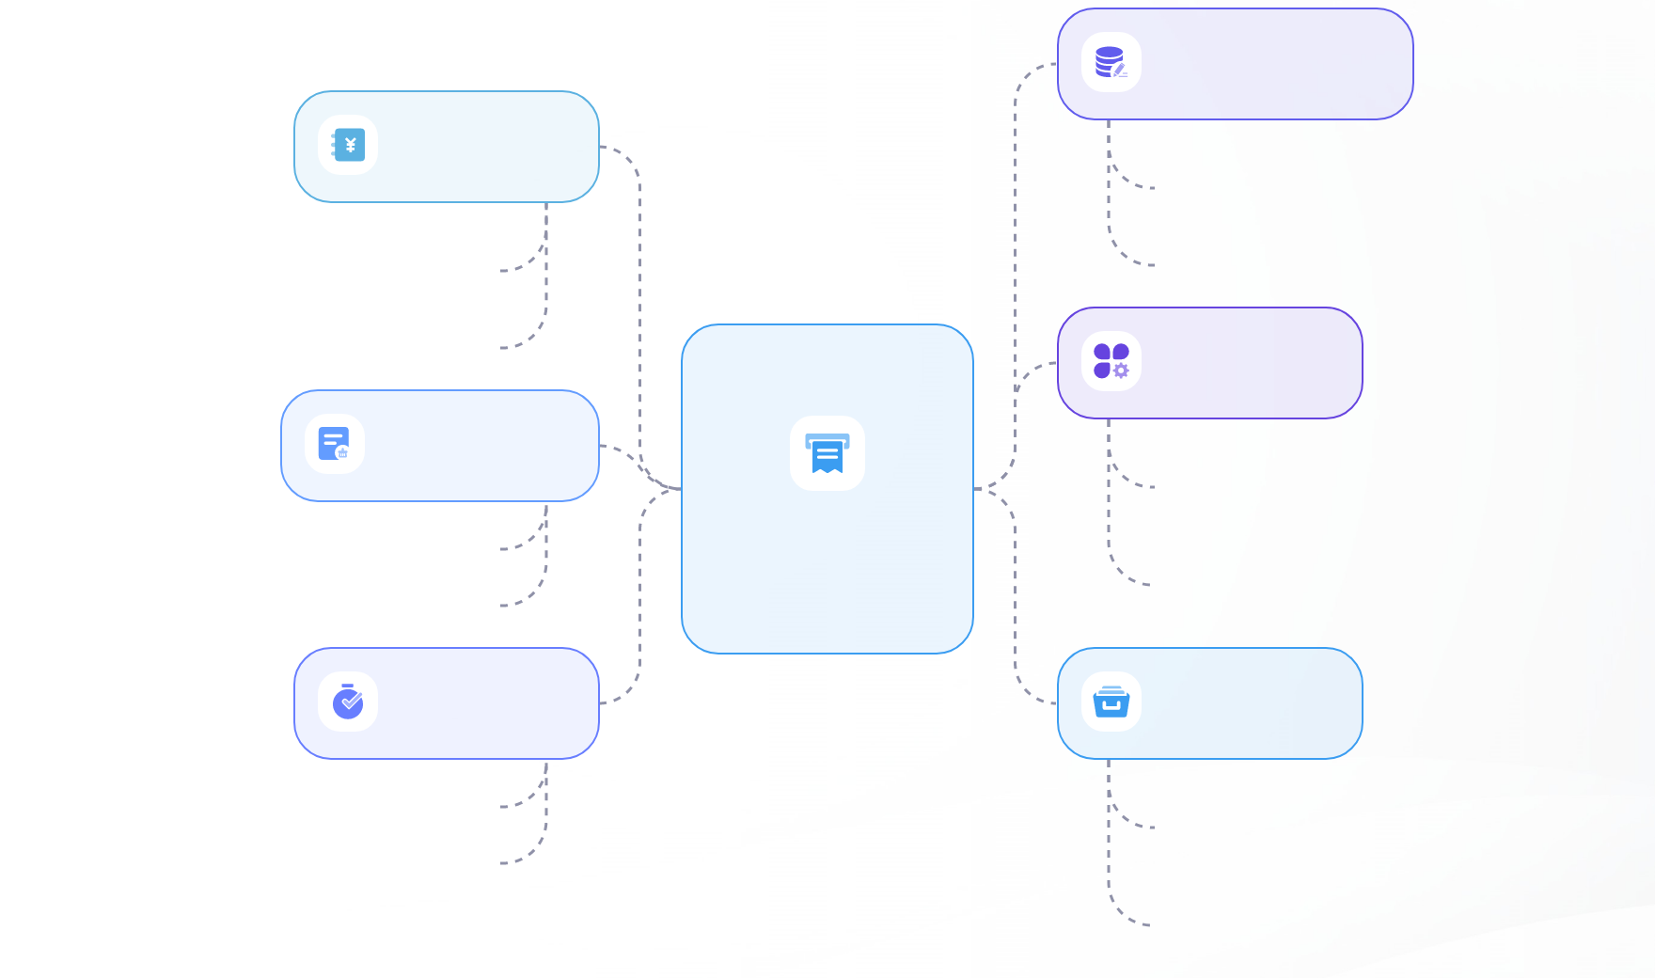
Basic concepts and terminology
Polygon edge clipping
Window cropping
When a polygon edge crosses the clipping boundary, the intersection point needs to be calculated.
Defines the convex polygonal areas to be retained, such as rectangles.
To determine the shape of the polygon after trimming.
Used to define the valid range of polygons.
The editing process
Polygon composition
It is implemented by calculating the intersection of polygon edges with the clipping boundary.
polygon clipping
Its made up of a series of connected line segments.
Ensure that the trimmed polygon remains valid geometric shape.
It needs to be cropped to fit the constraints of the cropping window.
Cropping boundaries
application area
Is the edge of each window in the trim.
Extensively used in computer graphics and geographic information systems.
Used to determine the positional relationship of polygon edges.
It helps to improve the efficiency of graphics display and data processing accuracy.

Slide 7
02
Core principles

Slide 8
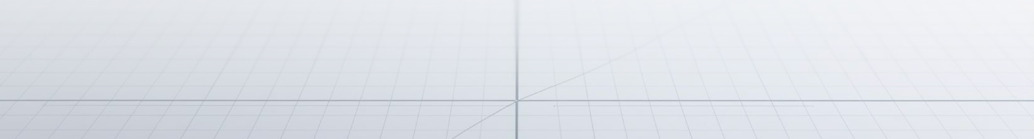
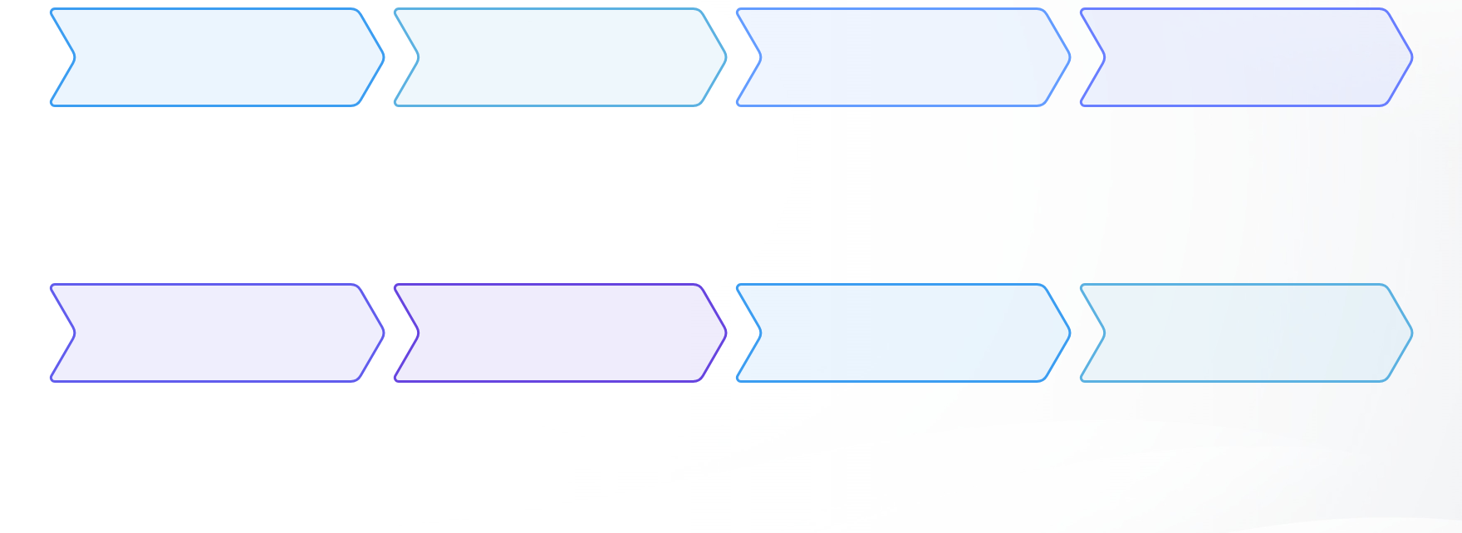
Definition of clipping window and polygon
01
02
03
04
Define the cropping window
Window shape characteristics
Polygon composition
The importance of convexity
The cropping window is usually rectangular and defines the reserved area.
The window is defined as a convex polygon to ensure that the algorithm is effective.
A polygon is formed by a series of vertices that need to be clipped.
Convexity ensures the simplicity and effectiveness of the algorithm.
05
06
07
08
Window border role
Object features to crop
Algorithm application conditions
Reserve boundaries defined
Clear window boundaries help guide cropping operations.
As a cropping object, polygon has clear geometric features.
The clipping algorithm is suitable for convex polygons to ensure simple operation.
Through the cropping window, the retained part of the image is clearly defined.

Slide 9



The selection and processing of the cropping boundary
Window definition
Border processing
Iterative cropping strategy
First, the cropping window is defined as a convex polygon, usually a rectangle, to define the retained area.
Trim the polygon from top to bottom, right to left in clockwise and counterclockwise order.
Update the vertices of the polygon on each side after trimming until all boundaries are processed.

Slide 10
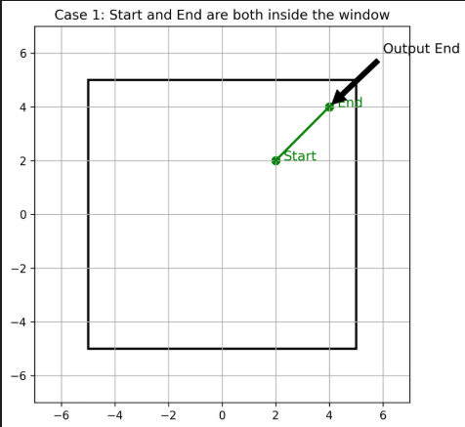




Detailed analysis of four cutting situations
Case 1: Internal traversal
When both ends of a polygon edge are in the window, the endpoint is retained directly to reflect integrity.
Case 2: Export clipping
If one end point is inside the window and the other is outside the window, calculate the intersection point and output it to achieve accurate cropping.
Case 3: Entry cropping
From the window out to the inside, output the intersection first and then the endpoint to ensure smooth boundary transition.
Case 4: Completely excluded
Both ends are outside the window. Ignore this side to avoid invalid data interference.

Slide 11
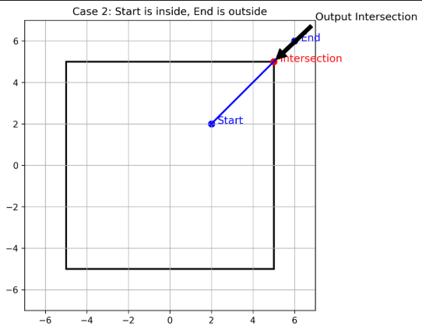
Detailed analysis of four cutting situations
Case 2: Export clipping
Case 1: Internal traversal
If one end point is inside the window and the other is outside the window, calculate the intersection point and output it to achieve accurate cropping.
When both ends of a polygon edge are in the window, the endpoint is retained directly to reflect integrity.

Slide 12
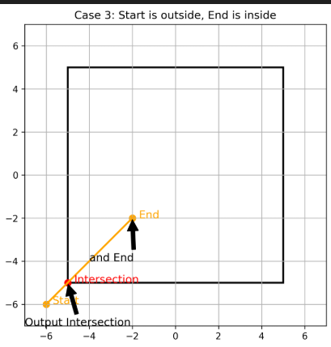
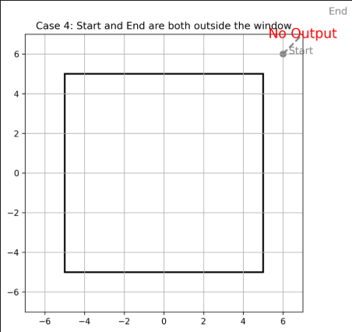
Detailed analysis of four cutting situations
Case 3: Entry cropping
Case 4: Completely excluded
From the window out to the inside, output the intersection first and then the endpoint to ensure smooth boundary transition.
Both ends are outside the window. Ignore this side to avoid invalid data interference.

Slide 13
03
Algorithm step details

Slide 14




Initialize the cropping window and polygon
Define the cropping window
Determining polygons
First, specify the geometry of the cropping window, usually a rectangle, whose boundaries define the valid area for polygon clipping.
Identify the polygon to be cropped, which consists of a series of vertex coordinates that are connected in sequence to form a closed shape.
Prepare for the cutting operation
Set the initial state, including the vertex list of the polygon and the boundary information of the clipping window, so as to prepare for the subsequent clipping steps.

Slide 15



Implementation strategy of cutting by the side
The choice of trimmings
Polygon edge processing
Iterative updates
Select each edge of the cropping window in sequence as the cropping boundary, usually starting from the top and moving clockwise or counterclockwise to the other three edges.
For each edge of a polygon, perform an exact clipping operation based on its relationship to the current clipping edge, which may include intersection calculation and vertex output.
After each cut, update the vertex list of the polygon, remove the vertices that are no longer applicable, and prepare to process the next cut boundary.

Slide 16
Iteration processing and result output
01
02
03
04
Update the vertex list
Recycling cutting boundaries
Result verification
Output the cropping results
After each cut, update the vertex list of the polygon, remove the vertices that are no longer applicable, and add the newly calculated intersection points.
Process each clipping boundary in order until all boundaries have been traversed, ensuring that the polygon fits completely into the clipping window.
Check the final vertex list to ensure that all vertices are located in the clipping window to ensure the accuracy of the clipping effect.
Output the final list of vertices, which represents the cropped polygon, which can be used for subsequent graphics rendering or further processing.

Slide 17
04
Graphic examples and practical applications

Slide 18
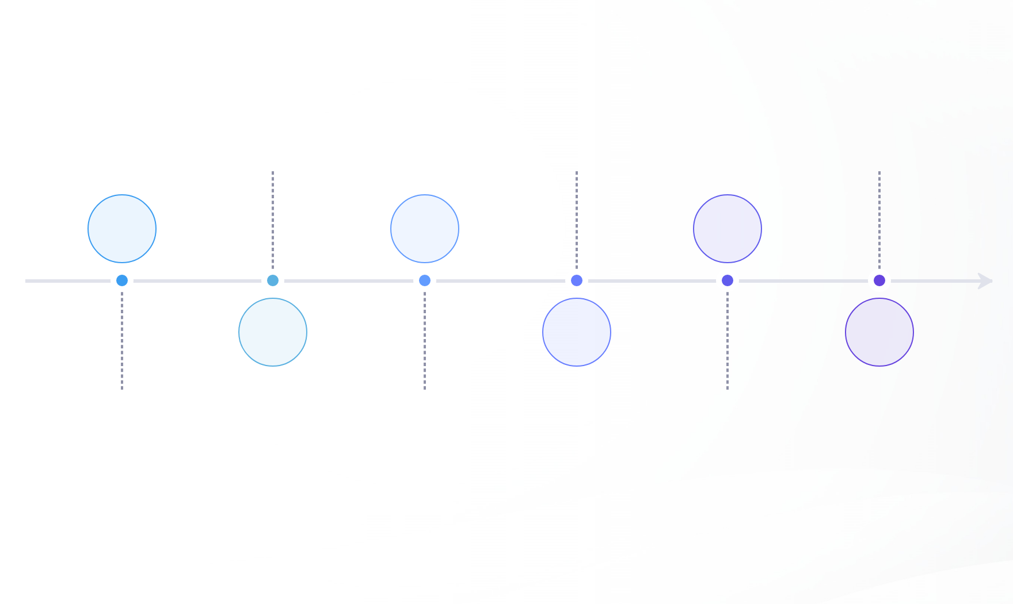
Four types of cropping graphics demonstration
Border exit processing
Totally external neglect
Dynamic interaction presentation
When the segment is moved from inside to outside the polygon, the intersection is calculated and output to accurately capture the moment of boundary contact.
When the line segment is completely outside the polygon, no output is performed to ensure the purity of the cropping result.
The algorithm not only pays attention to the static geometric position, but also pays attention to the dynamic interaction between polygons and windows.
01
03
05
02
04
06
Internal traversal records
Border entry operation
Polygon clipping algorithm
When the segment passes through the interior of the polygon, record its endpoint to ensure the integrity of the interior edge.
When the line segment enters the interior from the exterior of the polygon, the intersection point is output first and then the end point, vividly showing the dynamic interaction between the edge of the polygon and the window.
The effective polygon clipping is realized by four different processing conditions.

Slide 19




Application cases of algorithm in practical projects
Application in game development
Integration in CAD systems
Integration of Geographic Information Systems (GIS)
Virtual reality (VR) scene construction
In the game engine, the Sutherland-Hodgman algorithm is used to trim complex terrain models in real time, ensuring that only the visible parts are rendered and improving efficiency.
The CAD software uses this algorithm to accurately cut the polygon area on the engineering drawing, realize automatic design and modification, and improve the design accuracy.
The GIS platform uses this algorithm to process satellite images, automatically identify and crop specific geographic areas, and support urban planning and environmental monitoring.
In VR applications, algorithms help create immersive environments by cropping out unnecessary visual elements to optimize the user experience and reduce latency.

Slide 20
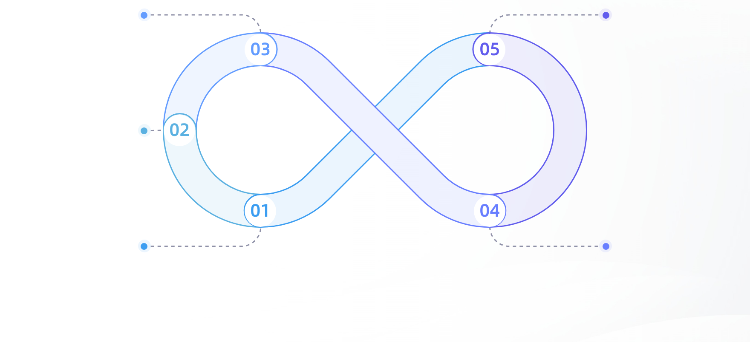
Optimization techniques and troubleshooting
High precision math library
Reducing computation
The intersection point calculation is performed using a high precision mathematical library to prevent clipping errors caused by floating point operation errors.
By means of early rejection and special treatment, the amount of data to be processed is significantly reduced and the computational complexity is reduced.
Special treatment of collinear edges
Polygon edges that are aligned with the cropping boundary are specially treated to avoid generating extra vertices or missing critical information.
Early rejection strategies
Optimize cutting efficiency
By eliminating polygons that are completely outside the window quickly, unnecessary calculations are reduced and efficiency is improved.
A variety of strategies and technical means are comprehensively used to effectively improve the overall efficiency of polygon clipping.

Slide 21
05
Performance analysis and limitations

Slide 22





Time complexity and space complexity of the algorithm
Time complexity analysis
Space complexity considerations
The time complexity of the Sutherland-Hodgman algorithm primarily depends on two factors: the number of vertices in the polygon and the number of edges in the clipping window. For each vertex, the algorithm must calculate intersections with every edge in the clipping window, resulting in a time complexity of O(n×m), where n represents the polygons vertex count and m denotes the number of edges in the clipping window.
The spatial complexity is primarily determined by the space required for the new vertices generated during storage trimming. In the worst case, each vertex may generate two new vertices, resulting in a spatial complexity of O (n), where n is the number of vertices in the original polygon.
optimization possibility
Practical factors of influence
Through preprocessing, such as quickly eliminating polygons that are completely outside the window, unnecessary calculations can be reduced, thus reducing the time complexity in some scenarios.
In practice, the shape and size of the polygon, the complexity of the clipping window, and the efficiency of intersection calculation all affect the actual running time of the algorithm.

Slide 23

The challenge of nonconvex polygon clipping
The concave area causes complex intersection
Complex intersection scenarios
Internal penetration problems make it harder
Multiple cuts may be needed to fit the window
The trimming process was difficult
The number of iterations is increased
Nonconvex polygon clipping
Multiple cuts lead to increased computation
Increased computation
Affect the execution efficiency of the algorithm
You need to find a balance between efficiency and accuracy
Algorithm efficiency and accuracy
Ensure that the cropping results are correct and efficient

Slide 24

The improvement direction and future trend of the algorithm
01
02
Real-time improvements
Nonconvex polygon support
Explore more efficient cropping algorithms to reduce computing time and meet real-time rendering requirements.
The research extension algorithm is used to deal with non-convex polygons and broaden its application scope.
03
Parallel computing applications
The parallel processing power of GPU is used to accelerate polygon clipping and improve the overall efficiency.

Slide 25
THANKS
The PPT content is generated by Tongyi AI. Visit tongyi.com Intelligence to generate more PPT

